Slide 1
Parallel and Distributed Computing
Lecture 1
Introduction

Slide 2
Aim of the course
to understand the fundamental concepts of parallel and distributed computing
design and analysis of Parallel algorithms
analyze different problems and develop parallel programming solutions of those problems
Study the challenges of Parallel and Distributed systems and how to cope with them

Slide 3
Outline
Motivating Parallelism
Computing vs Systems
Parallel vs Distributed Computing
Practical Applications of P&D Computing
Notes:
What and when

Slide 4
Lecture1: Introduction to Parallel Computing

Slide 5
Motivating Parallelism

Slide 6
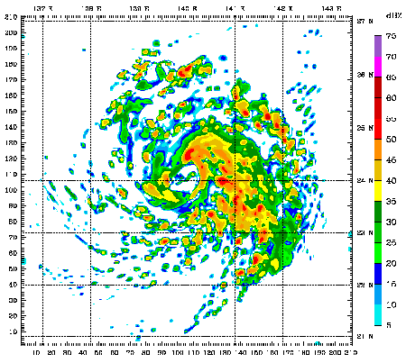

Motivation for Parallel and Distributed Computing
Uniprocessor are fast but
  Some problems require too much computation
  Some problems use too much data
  Some problems have too many parameters to explore
For example
  Weather simulations, gaming, web Servers, code breaking

Slide 7
Why Parallel Computing
Problems with large computing complexity
    Computing hard problems (NP-complete problems)
    exponential computing time.
    Problems with large scale of input size
    quantum chemistry, statistic mechanics, relative physics, universal physics, fluid
    mechanics, biology, genetics engineering, …
For example, it costs 1 hour using the current computer to simulate the procedure
of 1 second reaction of protein molecule and water molecule. It costs

Slide 8
Why parallel Computing
Physical limitation of CPU computational power
In past 50 years, CPU was speeded up double every 2.5 years. But, there are a physical limitation. Light speed is
Therefore, the limitation of the number of CPU clocks is expected to be about 10GHz.
To solve computing hard problems
  Parallel processing
  DNA computer
  Quantum computer
  …

Slide 9
Parallel Computing
Parallel computing is a computing where the jobs are broken into discrete parts that can be executed concurrently.
Each part is further broken down to a series of instructions. Instructions from each part execute simultaneously on different CPUs.
Parallel systems deal with the simultaneous use of multiple computer resources that can include a single computer with multiple processors, a number of computers connected by a network to form a parallel processing cluster or a combination of both.
Parallel systems are more difficult to program than computers with a single processor because the architecture of parallel computers varies accordingly and the processes of multiple CPUs must be coordinated and synchronized.

Slide 10
Motivating Parallelism
Developing parallel hardware and software has traditionally been time and effort intensive.
If one is to view this in the context of rapidly improving uniprocessor speeds, one is tempted to question the need for parallel computing.
Latest trends in hardware design indicate that uni-processors may not be able to sustain the rate of realizable performance increments in the future .
This is the result of a number of fundamental physical and computational limitations.
The emergence of standardized parallel programming environments, libraries, and hardware have significantly reduced time to develop (parallel) solution.
Notes:
Parallelism requires time and effort
If uniprocessor is so fast why we need parallel computing?
Good but it is just not enough because of physical and computational limitations
Solution: Standardized parallel programming environment, libraries and hardware

Slide 11
Motivating Parallelism
Moore’s Law
Proposed by Gorden E. Moore in 1965 and revised in 1975.
It states that [Simplified Version]
“Processing speeds, or overall processing power for computers will double every18 months.”
A more technically correct interpretation
“The number of transistors on an affordable CPU would double every two years [18 months].”

Slide 12
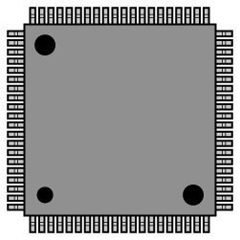
What is parallel computing
  Using a number of processors to process one task
  Speeding up the processing by distributing it to the processors
One problem

Slide 13
Classification of parallel computers
M.J. Flynn proposed a classification for the organization of a computer system by the number of instructions and data items that are manipulated simultaneously.
The sequence of instructions read from memory constitutes an instruction stream.
The operations performed on the data in the processor constitute a data stream.
  Two kinds of classification
  １．Flann’s Classification
    SISD (Single Instruction stream, Single Data stream)
    MISD (Multiple Instruction stream, Single Data stream)
    SIMD (Single Instruction stream, Multiple Data stream)
    MIMD (Multiple Instruction stream, Multiple Data stream)
2. Classification by memory status
    Share memory
    Distributed memory

Slide 14
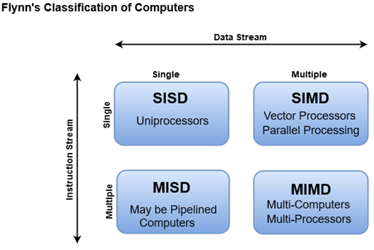

Slide 15
Flynn’s classification(1)
SISD (Single Instruction Single Data) computer
  Von Neuman’s one processor computer
Control
Processor
Memory
Instruction
Data
Stream
Stream

Slide 16
Flynn’s classification (2)
MISD (Multi Instructions Single Data) computer
All processors share a common memory, have their own control devices and execute their own instructions on same data.
Control
Processor
Instruction
Stream
Control
Processor
Instruction
Stream
Memory
Data
Stream
Control
Processor
Instruction
Stream

Slide 17
Flynn’s classification (3)
SIMD (Single Instructions Multi Data) computer
  Processors execute the same instructions on different data
  Operations of processors are synchronized by global clock.
Processor
Data
Shared
Stream
Memory
Processor
Control
Data
or
Instruction
Stream
Stream
Inter-
connection
Processor
Nerwork
Data
Stream

Slide 18
Flynn’s classification (4)
MIMD (Multi Instruction Multi Data) Computer
  Processors have their own control devices, and execute different instructions on different data.
  Operations of processors are executed asynchronously in most time.
  It is also called as distributed computing system.
Control
Processor
Instruction
Data
Shared
Stream
Stream
Memory
Control
Processor
Instruction
Data
Stream
or
Stream
Inter-
connection
Control
Processor
Nerwork
Instruction
Data
Stream
Stream

Slide 19
Classification by memory types (1)
1. Parallel computer with a shared common memory
  Communication based on shared memory
  For example, consider the case that processor i sends some data to processor j. First, processor i writes the data to the share memory, then processor j reads the data from the same address of the share memory.
Processor
Processor
Shared
Memory
Processor

Slide 20
Classification by memory types (2)
Features of parallel computers with shared common memory
  Programming is easy.
  Exclusive control is necessary for the access to the same memory cell.
  Realization is difficult when the number of processors is large.
      （Reason) The number of processors connected to shared memory is limited by the physical factors such as the size and voltage of units, and the latency caused in memory accessing.

Slide 21
Classification by memory tapes (3)
2. Parallel computers with distributed memory
    Communication style is one to one based on interconnection network.
    For example, consider the case that processor i sends data to processor j. First, processor i issues a send command such as “processor j sends xxx to process i”, then processor j gets the data by a receiving command.

Slide 22
Classification by memory types (4)
Features of parallel computers using distributed memory
There are various architectures of interconnection networks (Generally, the degree of connectivity is not large.)
Programming is difficult since comparing with shared common memory the communication style is one to one.
It is easy to increase the number of processors.

Slide 23
Types of parallel computers with distributed memory
Complete connection type
  Any two processors are connected
  Features
    Strong communication ability, but not practical
    (each processor has to be connected to many processors).
  Mash connection type
  Processors are connected as a two-dimension lattice.
  Features
  - Connected to few processors. Easily to increase
      the number of processors.
      Large distance between processors:
      Existence of processor communication bottleneck.

Slide 24
Types of parallel computers with distributed memory
Hypercube connection type
  Processors connected as a hypercube (each processor has a binary number. (Processors are connected if only if one bit of their number are different.）
    Features
    Small distance between processors: log n.
    Balanced communication load because of its symmetric structure.
    Easy to increase the number of processors.

Slide 25
Types of parallel computers with distributed memory
  Other connected type
  Tree connection type, butterfly connection type, bus
  connection type.
  Criterion for selecting an inter-connection network
  Small diameter (the largest distance between processors)
  for small communication delay.
  Symmetric structure for easily increasing the number of
  processors.
The type of inter-connection network depends on
application, ability of processors, upper bound of
the number of processors and other factors.

Slide 26
Real parallel processing system (1)
Early days parallel computer (ILLIAC IV)
  Built in 1972
  SIMD type with distributed memory, consisting of
  64 processors
Transformed mash connection type,
equipped with common data bus,
common control bus, and one control
Unit.

Slide 27
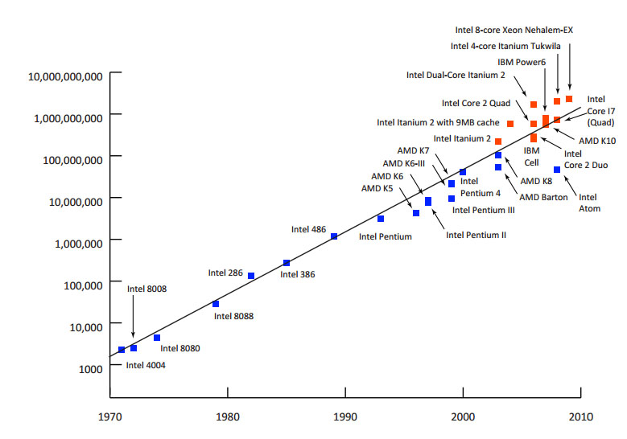
Moore’s law
Number of transistors incorporated in a chip will approximately double every two years.

Slide 28
Motivating Parallelism
Moore’s Law
More computational power implicitly means more transistors.
Then why need second interpretation?
Let’s have a look on empirical data from 1970 to 2009
  In 1970’s (i.e., from 1970 to 1979), processor speeds ranged from 740 KHz to 8 Mhz. Difference shows that both the interpretations are correct.
  From 2000 to 2009, Speeds ranged from 1.3 GHz to 2.8 GHz.
  Speed difference is too low but, number of integrated transistors ranged from 37.5 million to 904 million.
  So, second interpretation is more accurate.

Slide 29
Motivating Parallelism
Moore’s Law
Why doubling the transistors does not doubles the speed?
  The answer is increase in number of transistor per processor is due to multi-core CPU’s.
  It means, to follow Moore’s law, companies had to:
    Introduce ULSI( ultra large-scale integrations)
    And multi-core processing era.
Will Moore’s law hold forever?
  Adding multiple cores on single chip causes heat issues.
  Furthermore, increasing the number of cores, may not be able to increase speeds [Due to inter-process interactions].
  Moreover, transistors would eventually reach the limits of miniaturization at atomic levels
Notes:
Ultra large-scale integration (ULSI) is the process of embedding millions of transistors on a single silicon semiconductor microchip.

Slide 30
Motivating Parallelism
Moore’s Law
So, we must look for efficient parallel software solutions to fulfill our future computational needs.
As stated earlier, number of cores on a single chip also have some restrictions.
Solution[s]?
  Need to find more scalable distributed and hybrid solutions
Notes:
What are the efficient solutions: parallel software

Slide 31
Motivating Parallelism
The Memory/Disk Speed Argument
While clock rates of high-end processors have increased at roughly 40% per year over the past decade, DRAM access times have only improved at the rate of roughly 10% per year over this interval.
This mismatch in speeds causes significant performance bottlenecks.
Parallel platforms provide increased bandwidth to the memory system.
Parallel platforms also provide higher aggregate caches.
Some of the fastest growing applications of parallel computing utilize not their raw computational speed, rather their ability to pump data to memory and disk faster.
Notes:
CPU is fast but memory isn’t, which is a mismatch in context of parallel programming.
Solution: parallel platform (increased bandwidth to memory) and combination or collection of caches

Slide 32
Motivating Parallelism
The Data Communication Argument
As the network evolves, the vision of the Internet as one large computing platform has emerged.
In many applications like databases and data mining problems, the volume of data is such that they cannot be moved.
Any analyses on this data must be performed over the network using parallel techniques

Slide 33
Computing vs Systems
Distributed Systems
A collection of autonomous computers, connected through a network and distribution middleware.
  This enables computers to coordinate their activities and to share the resources of the system.
  The system is usually perceived as a single, integrated computing facility.
  Mostly concerned with the hardware-based accelerations
Distributed Computing
A specific use of distributed systems, to split a large and complex processing into subparts and execute them in parallel, to increase the productivity.
  Computing mainly concerned with software-based accelerations (i.e., designing and implementing algorithms)
Notes:
Electronic engineering vs Software development

Slide 34
Parallel vs Distributed Computing
Parallel (shared-memory) Computing
The term is usually used for developing concurrent solutions for following two types of the systems:
  Multi-core Architecture
  Many core architectures (i.e., GPU’s)
Distributed Computing
This type of computing is mainly concerned with developing algorithms for the distributed cluster systems.
Here distributed means a geographical distance between the computers without any shared-Memory.
Notes:
Electronic engineering vs Software development
Graphics Processing Unit: GPU

Slide 35
Practical Applications of P&D Computing
Scientific Applications
Functional and structural characterization of genes and proteins
Applications in astrophysics have explored the evolution of galaxies, thermonuclear processes, and the analysis of extremely large datasets from telescope.
Advances in computational physics and chemistry have explored new materials, understanding of chemical pathways, and more efficient processes
  e.g., Large Hydron Collider (LHC) at European Organization for Nuclear Research (CERN) generates petabytes of data for a single collision.
Notes:
DLSF—Distributed Load Sharing facility

Slide 36
Practical Applications of P&D Computing
Scientific Applications
Bioinformatics and astrophysics also present some of the most challenging problems with respect to analyzing extremely large datasets.
Weather modeling for simulating the track of a natural hazards like the extreme cyclones (storms).
Flood prediction
Notes:
DLSF—Distributed Load Sharing facility

Slide 37
Practical Applications of P&D Computing
Commercial Applications
Some of the largest parallel computers power the wall street!
Data mining-analysis for optimizing business and marketing decisions.
Large scale servers (mail and web servers) are often implemented using parallel platforms.
Applications such as information retrieval and search are typically powered by large clusters.
Notes:
Worlds largest stock exchange in Newyork

Slide 38
Practical Applications of P&D Computing
Computer Systems Applications
Network intrusion detection: A large amount of data needs to be analyzed and processed
Cryptography (the art of writing or solving codes) employs parallel infrastructures and algorithms to solve complex codes.
Graphics processing
Embedded systems increasingly rely on distributed control algorithms. E.g. modern automobiles
Notes:
(NIDS) are responsible for monitoring traffic on packet level. intrusion= disturbance
Convolutions, Rendering(In computer graphics, rendering is the process by which an abstract description of a scene is converted to an image)

Slide 39
Limitations of Parallel Computing:
It requires designing the proper communication and synchronization mechanisms between the processes and sub-tasks.
Exploring the proper parallelism from a problem is a hectic process.
The program must have low coupling and high cohesion. But it’s difficult to create such programs.
It needs relatively more technical skills to code a parallel program.
Notes:
Coupling and cohesion in terms of Data and operations on it.

Slide 40

Questions

